Slide 1
CS 4476 Project 2
Yunqing Jia
yjia67@gatech.edu
903256707

Slide 2
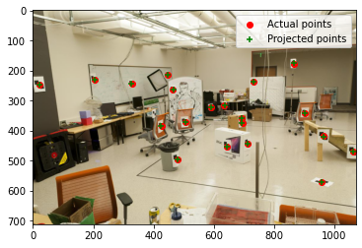
Part 1.5: Projection Matrix for provided image
<insert visualization of projected 3D points and actual 2D points for image provided by us here [1]>
<What is the minimum number of 3D-2D point correspondences needed to estimate the projection matrix? Why? [2]>
A minimum of 6 point-correspondences are needed because there are 11 unknown parameters in the projection matrix and each correspondence yields 2 equations (6x2 = 12 equations).

Slide 3
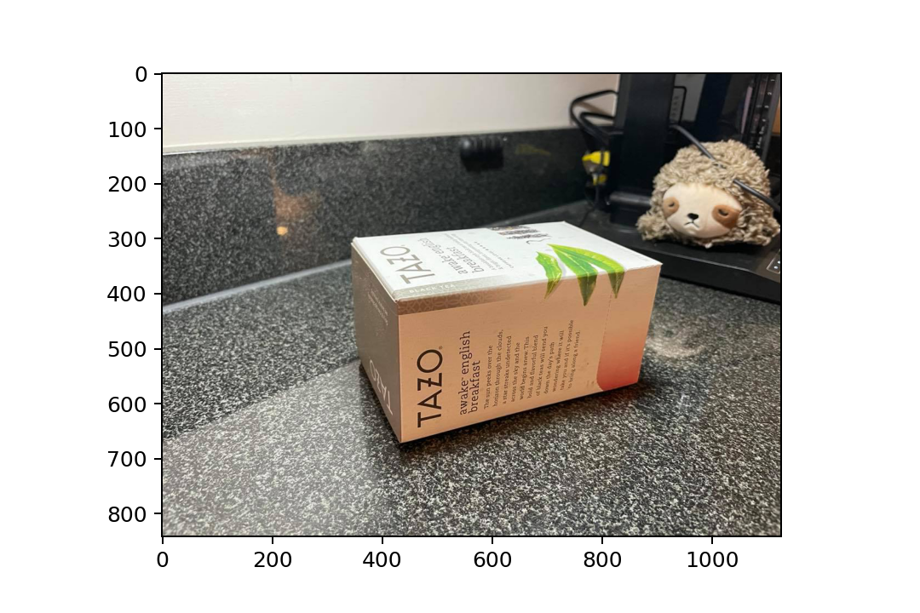
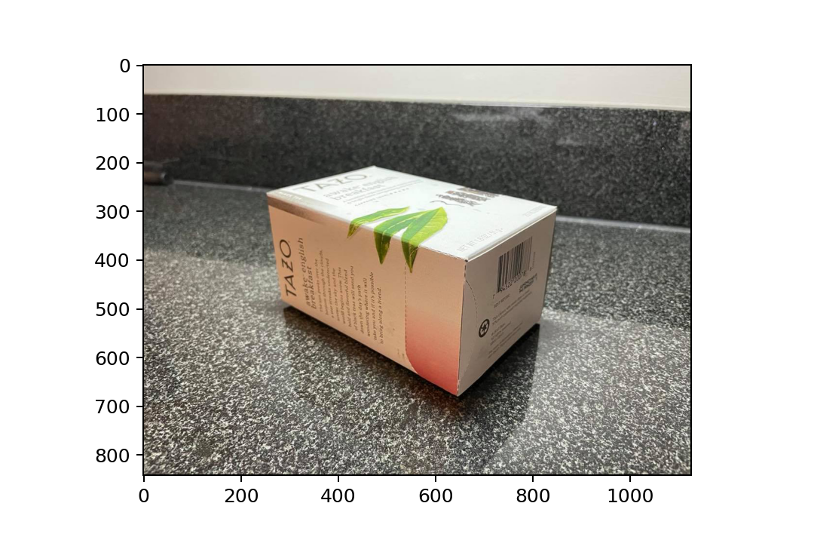
Part 2.1: Projection Matrix for custom images
<Copy two images of your fiducial object here [2]>
box_img1.jpg box_img2.jpg

Slide 4
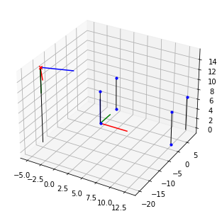
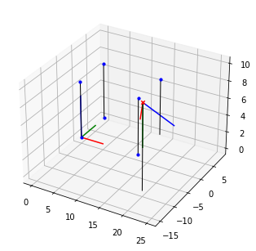
Part 2.2: Pose init for custom images
<Insert visualization for the initialized camera pose for 1st image> [1]
<Insert visualization for the initialized camera pose for 2nd image> [1]

Slide 5
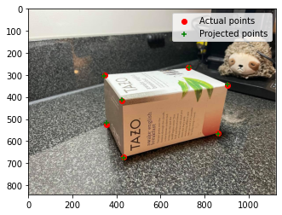
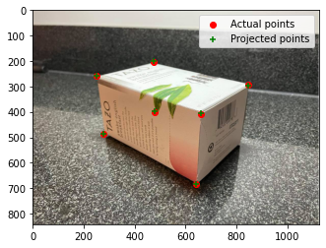
Part 2.2: Optimized results for custom images
<Insert visualization for projected 3D points and actual 2D points for 1st image> [1.5]
<Insert visualization for projected 3D points and actual 2D points for 2nd image> [1.5]

Slide 6
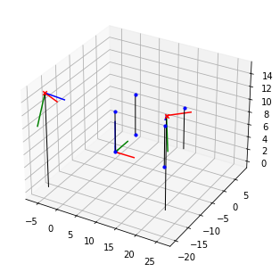
Part 2.3: Optimized Camera Poses
<Insert pose with world and optimized camera’s coordinate systems [1]>

Slide 7
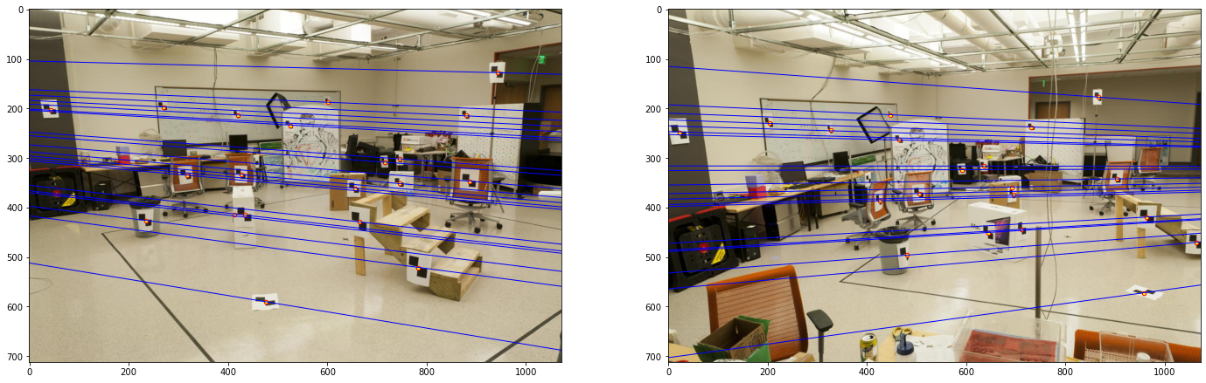
Part 3.2: Optimized Epipolar Lines (given images)
<Insert left image with epipolar lines> [1]
<Insert right image with epipolar lines> [1]

Slide 8
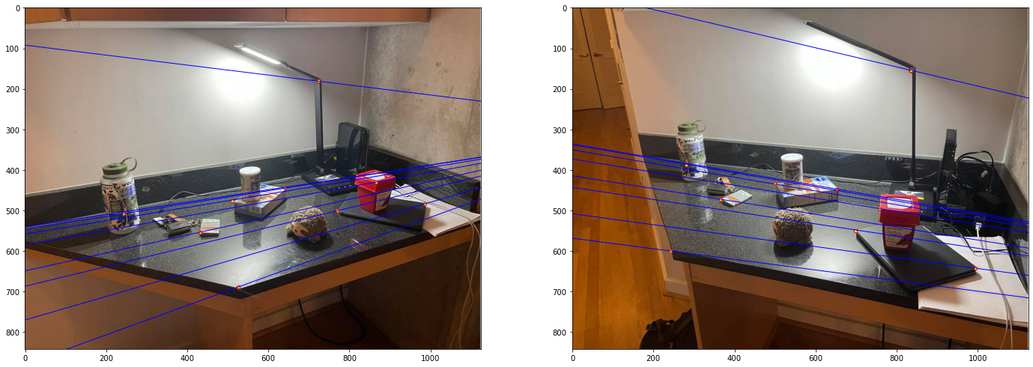
Part 3.3: Optimized Epipolar Lines (custom images)
<Insert left image with epipolar lines> [1.5]
<Insert right image with epipolar lines> [1.5]

Slide 9
Part 3.4: Reflection Questions [1x3]
1. Because rotating and zooming (scaling) operations are linear and the two images would remain in same/parallel image planes and the epipoles would be at infinity. Also, there would be an infinite number of converging points.
2. The goal is to compute the correlation between the two camera planes. Given corresponding points between two images, the fundamental matrix can be recovered.
3. The epipolar lines would converge toward a point in the image and the epipoles would coincide because the camera center of one image would be captured in the other image.

Slide 10
Part 3.4: Reflection Questions [1x3]
4. It means that the two camera planes are parallel to each other.
5. Because the fundamental matrix is not unique depending on the correspondences used.
6. The fundamental matrix is rank 2 because we are mapping from a 2D plane onto a 1D projective line.

Slide 11
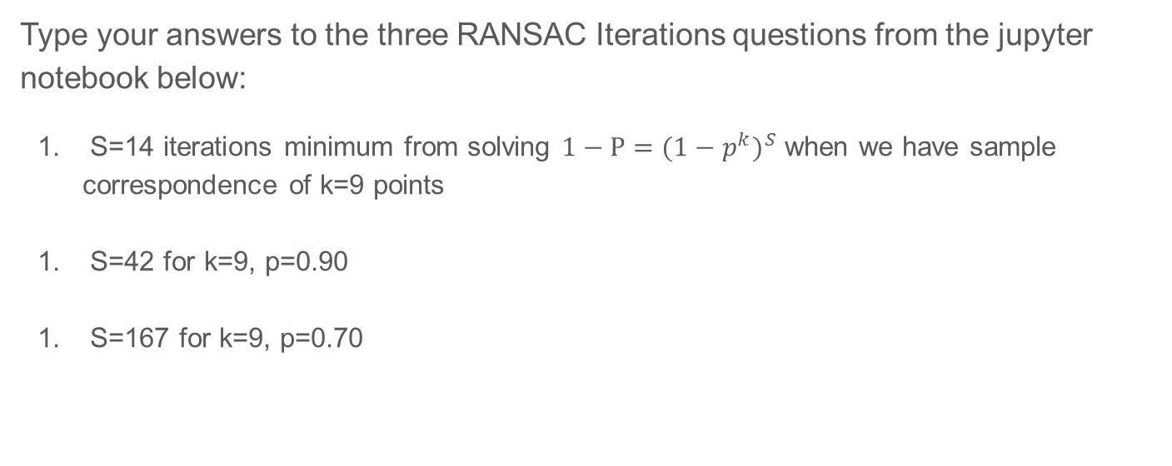
Part 4.2: RANSAC Iterations Questions [1x3]
Type your answers to the three RANSAC Iterations questions from the jupyter notebook below:
S=14 iterations minimum from solving ${1−P=({1−p}^{k})}^{S}$ when we have sample correspondence of k=9 points
S=42 for k=9, p=0.90
S=167 for k=9, p=0.70

Slide 12
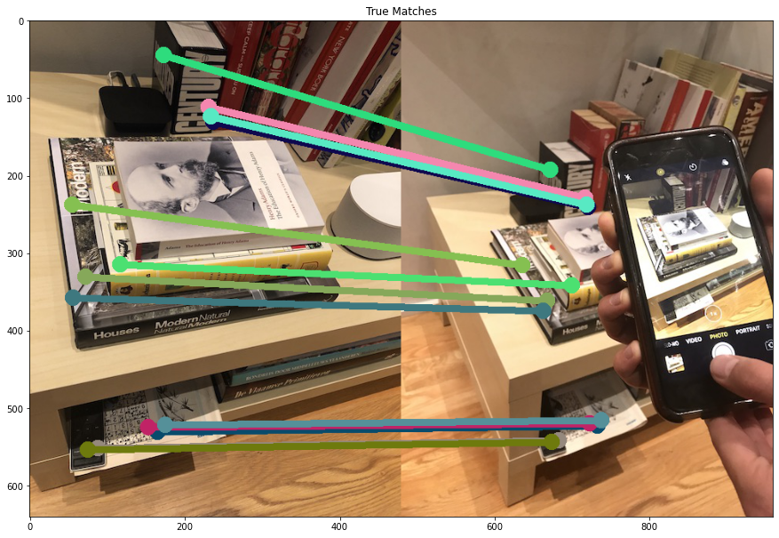
Part 4.4: RANSAC Inlier Matches
<Paste the inlier matches found by Ransac [2]>

Slide 13
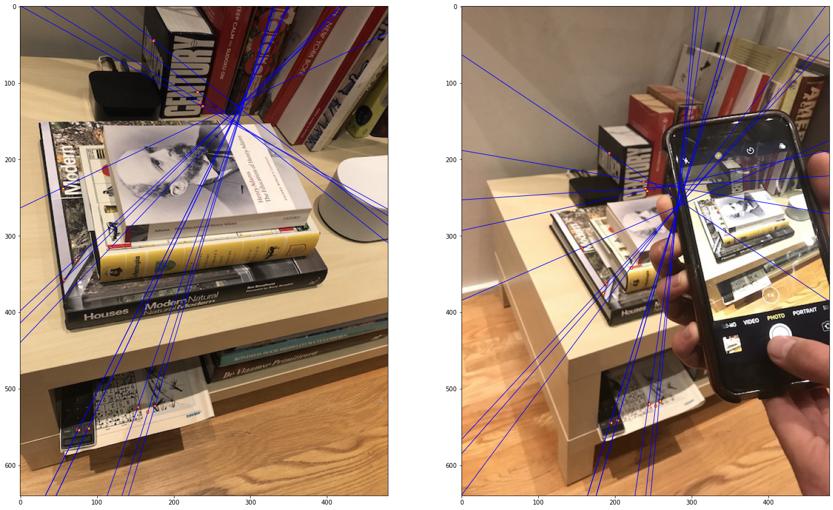
Part 4.4: RANSAC Epipolar Lines
<Paste the left image with epipolar lines> [1]
<Paste the right image with epipolar lines> [1]

Slide 14
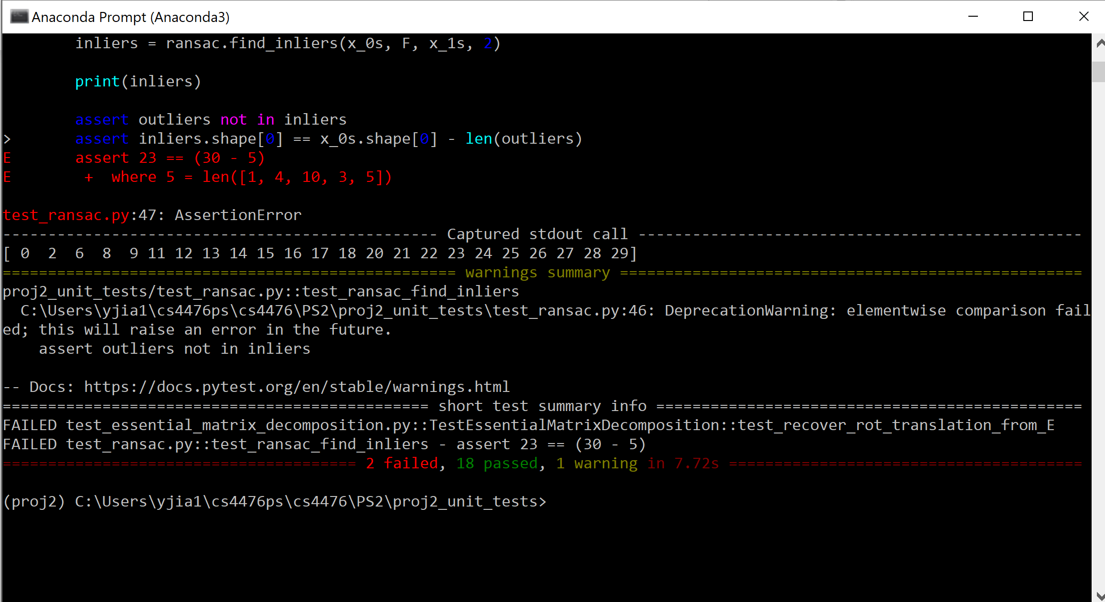
Local Unit tests results
<Paste the screenshot when you run all provided unit tests using `pytest`> [1]

Slide 15
Conclusions
<Describe what you have learned in this project. Feel free to include any challenges you ran into.> [2]
I enjoyed being able to use pictures I took and run the projection matrix and camera pose visualization on them. Doing the homework definitely helped me grasp RANSAC and the implication of different hyper parameters as well.

